Slide 1


2025 Summer Virtual CME Series
Hormone Therapy for Women
Melodie Stocks, DO
Hormone Therapy for Men
Gregory McLennan, MD

Slide 2
Hormone Therapy for Women
Easing Menopause
Melodie Stocks DO

Slide 3
Disclosures
None

Slide 4
Objectives
Discuss who will benefit from hormone therapy
Overview of risks and contraindications
Describe preparations, side effects and discontinuation of hormone therapy
Overview of treatment of genitourinary syndrome of menopause
Review use of testosterone in women

Slide 5
What is HT?
Hormone therapy (HT) or menopausal hormone therapy (MHT) refers to the systemic treatment of perimenopausal and menopausal symptoms with estrogen and may include a progestin
It does not refer to the topical use of estrogen or DHEA for the treatment of Genitourinary Syndrome of Menopause (GSM)
Bioidentical hormone therapy is a marketing term used in several ways but generally to describe hormones that are molecularly identical (isomolecular) to human estradiol (E2) and progesterone

Slide 6
Candidates for treatment
Symptomatic women without contraindications
Average age of menopause is 51.4 years
Average onset of symptoms is 4 years prior to the last menses
May still be having regular menses
All symptoms are the result of estrogen deficiency
Generally, HT is initiated before age 60 (not necessarily discontinued by this age)

Slide 7
Symptoms
Changes in cycle length
Hot flushes
Night sweats
Menopause sleep disorder
Vaginal dryness, itching, burning, dyspareunia (GSM)
Mood and memory changes
Increased facial hair, thinning skin
Hair loss
Increased abdominal fat
Menstrual related migraines
Restless legs

Slide 8
Work up
Under age 45 screen for pregnancy, PCOS, hyperprolactinemia, anovulation due to obesity, thyroid disorder, diabetes
If the FSH is over 30 under the age of 40, menopause is generally confirmed, and diagnosis is Primary Ovarian Insufficiency
Over age 45 if the symptoms are consistent with menopause, no work up is needed
Day 3 FSH is the most useful lab but can be normal in perimenopause
If unexpected or unusual FSH results, draw twice

Slide 9
Contraindications to HT
Undiagnosed Bleeding
Known or suspected estrogen-dependent neoplasia
History of thromboembolism
Known or suspected pregnancy
Liver disease or dysfunction
Active or recent myocardial infarction or stroke
Hypersensitivity to hormone therapy preparations
Smoking and migraines are not contraindications

Slide 10
Basic principles
Systemic hormone therapy is prescribed for vasomotor symptoms and mood changes at the lowest effective dose
Duration is guided by symptoms should be individualized
If the uterus is present, it must be protected with a progestin—oral or IUD (off-label) or a selective estrogen receptor modifier (SERM)
Local therapy is recommended if only vaginal symptoms (GSM)

Slide 11
Type of estrogen caveats
Conjugated equine estrogen (CEE) and estradiol (E2) are FDA-approved for HT
CEE is more potent, contains at least 10 types of estrogen including types not similar to human estrogens (Premarin, Prempro, Premphase, Duavee)
CEE binds predominantly to β receptors and increases CRP and other pro-inflammatory markers that are responsible for atherosclerotic plaque rupture
E2 binds to ⍺ and β receptors and is associated with decreased risk of atherosclerosis
Case control study has show decrease in stroke with E2 compared to CEE but more research is needed

Slide 12
Timing of estrogen caveats
WHI population was 10+ years older than average age of woman seeking HT as it was studying the prevention of CVD in older women
Initiation of HT at onset of menopause is likely to be protective for CVD as was seen in the subgroup of CEE-alone women 50-59 in a 13-year follow up of the WHI. This group had a 40% lower MI risk and lower all-cause mortality than the placebo group
The timing or gap hypothesis is that estrogen is protective when initiated at menopause and riskier when started more than 10 years after menopause

Slide 13
Route of estrogen caveats
Data is conflicting but suggests that oral estrogen therapy increases stroke risk
Low-dose transdermal estrogen does not increase stroke risk
Large population based studies have shown no increase risk of stroke in postmenopausal women using low dose E2 (<50 mcg) patches but was increased in doses over 50 mcg/day

Slide 14
Estrogen and breast cancer
Spoiler: Estrogen does not increase breast cancer risk
At 18-years of follow up the WHI CEE-alone group had a 45% reduction in breast cancer mortality compared to placebo
The increased risk in breast cancer in the CEE+MPA was extremely small and after long-term follow up there was no increase in breast cancer mortality
Large Finnish observational study showed any history of E2-based HT, with or without a progestin, was associated with 50% breast cancer mortality risk reduction for more than 10 years in all age groups

Slide 15
Progestins
Medroxyprogesterone acetate (MPA) and micronized progesterone are FDA-approved for HT
MPA binds to progesterone, androgen and glucocorticoid receptors
MPA increases insulin-like growth factor 1, increases insulin resistance and increases thrombotic risk when combined with estrogen
Continuous MPA may increase of breast cancer when combined with estrogen
Norethindrone or MPA alone may improve vasomotor symptoms (off-label)
Oral micronized progesterone has not been associated with increased risk of VTE or breast cancer

Slide 16
Available estrogen preparations
Estradiol (E2) is available in many forms: oral, transdermal patches, topical gels, vaginal rings and vaginal tablets. IV, IM and pellets are not recommended for postmenopausal HT
Patient preference, availability and cost guide choice
A standard dose of oral 1 mg/day or transdermal 0.05 mg/day is usually effective in reducing symptoms
Reasonable to start estradiol at 0.5 mg oral or 0.025 mg patch and go up if needed
Young women with recent oophorectomy may require higher dose up to 2 mg oral or 0.1 mg transdermal
CEE (Premarin) is branded and available in 1.25 mg, 0.9 mg, 0.625 mg, 0.45 mg, 0.3 mg oral doses

Slide 17
Endometrial protection
Progestins are used in combined HT for endometrial protection. Not needed after hysterectomy.
Micronized progesterone 100 mg daily orally or 200 mg 14 days a month is first line
Recommend taking at bedtime as it can cause drowsiness
MPA 2.5 mg orally is standard dose but increased risks compared to progesterone
Bazedoxifene is a SERM used for endometrial protection in Duavee which is a CEE product. Useful in women who do not tolerate progestins or have breast tenderness. There is an increased risk of VTE like other SERMs.

Slide 18
Side effects
Breast soreness is common side effect of estrogen. Lowering the dose is usually effective.
Vaginal bleeding is common in cyclic progesterone throughout therapy and in the early months of continuous estrogen-progestin regimen
Cyclical progestin may cause mood sides effect and bloating
Endometrial biopsy indicated if bleeding beyond first 6 months of continuous estrogen-progestin HT

Slide 19
Duration and discontinuation
Standard recommendation has been 5 years and not beyond age 60
Cardiovascular and VTE risks are likely highest in first year of use
Some women continue to have vasomotor symptoms for 10-20 years after the last menstrual period
ACOG and The Menopause Society agree that HT should be individualized and not discontinued solely based on age
40-50% of women who start HT stop within one year and 65-75% with in 2 years, often without guidance from health care provider

Slide 20
Discontinuation
No standard taper but generally decrease by one pill a week over 2-4 weeks
Taper over 3 months to a year
Symptomatic women generally go back on HT
Starting a nonhormonal therapy for hot flashes such as a SSRI or gabapentin when tapering can help

Slide 21
Alternatives for vasomotor symptoms
Fezolinetant (Veozah) is a neurokinin 3 receptor antagonist approved for treatment of menopausal hot flushes and requires LFTs prior to initiation, monthly for 3 mint and then at 6 and 9 months or symptoms of liver injury
The only SSRI FDA approved for hot flashes is paroxetine. It cannot be taken with tamoxifen. Citalopram, escitalopram, venlafaxine, desvenlafaxine have similar modest benefit and okay with tamoxifen
Sertraline and fluoxetine have not shown benefit and should not be used in women taking tamoxifen
Off-label therapies that have shown benefit in studies include pregabalin, gabapentin, clonidine and oxybutynin
CBT, mindfulness and stellate ganglion blocks have shown promise for hot flashes

Slide 22
Treatment of GSM
First line is vaginal moisturizers and lubricants
Vaginal estrogen is indicated for persistent symptoms and is available in CEE (cream) and E2 preparations (cream, ring, tablet)
Contraindicated in patients with active estrogen-dependent tumors on anti-estrogen therapy
Limited systemic absorption so progestin is not generally needed
Vaginal DHEA (prasterone—Intrarosa) is a daily vaginal capsule used to treat dyspareunia due to GSM, useful in women who value avoiding estrogen (it converts to estrone)
Ospemifene (Osphena) is oral SERM approved for treating dyspareunia and vaginal dryness. Hot flushes is most common side effect (6%). Potentially protective for breast and bone. Possible VTE risk.

Slide 23
Testosterone therapy
Not recommended for menopause hormone therapy but may be used in postmenopausal women with sexual disorders
Levels of endogenous androgens do not predict sexual function in women
No FDA approved testosterone preparation for females
Dosing is 10% or less of standard male dose and is compounded

Slide 24
References and Resources
Obstetrics and Gynecology, 9th ed. Robert Casanova et al, Wolters Kluwer, 2023. ISBN-13:978-1975180577
Management of menopausal symptoms. Practice Bulletin No. 141. American College of Obstetricians and Gynecologists. Obstet Gynecol 2104;123:202-16. Reaffirmed 2024.
Levy B, Simon J. A Contemporary view of menopausal hormone therapy. Obstet Gyencol 2024;144:12-23.
Martin KA, Barbieri LA. Treatment of menopausal symptoms with hormone therapy. In UpToDate, Connor RF (Ed), Wolters Kluwer. (Accessed April 13, 2025.)
menopauseˌorg The Menopause Society, formerly the North American Menopause Society, has patient and provider resources.

Slide 25
Testosterone TherapY…
Worth the hype?
Gregory Mclennan, MD
Mercy Clinic urology, mercy hospital st. louis

Slide 26
Gregory Mclennan, MD
Board Certified in Urology by the American Board of Urology
General Urologist at Mercy Clinic Urology practicing at Mercy Hospital St. Louis
Regional Strategic Chair Surgery and GI, Mercy Clinic East Communities
Chairman, Department of Surgery, Mercy Hospital St. Louis

Slide 27
Financial disclosures
Speaker for Abbvie Pharmaceutical Corporation
Consultant for Calyxo Inc.
Consultant for Storz Endoscopy
Consultant for Pathnostics

Slide 28
Learning Goals
Epidemiology
Causes of low T
Normal T Range
  Free T
Treatment options
Benefits of testosterone replacement
Risks of testosterone replacement
Testosterone and Prostate Cancer

Slide 29

Andropause: Androgen Deficiency in the Aging Male

Slide 30

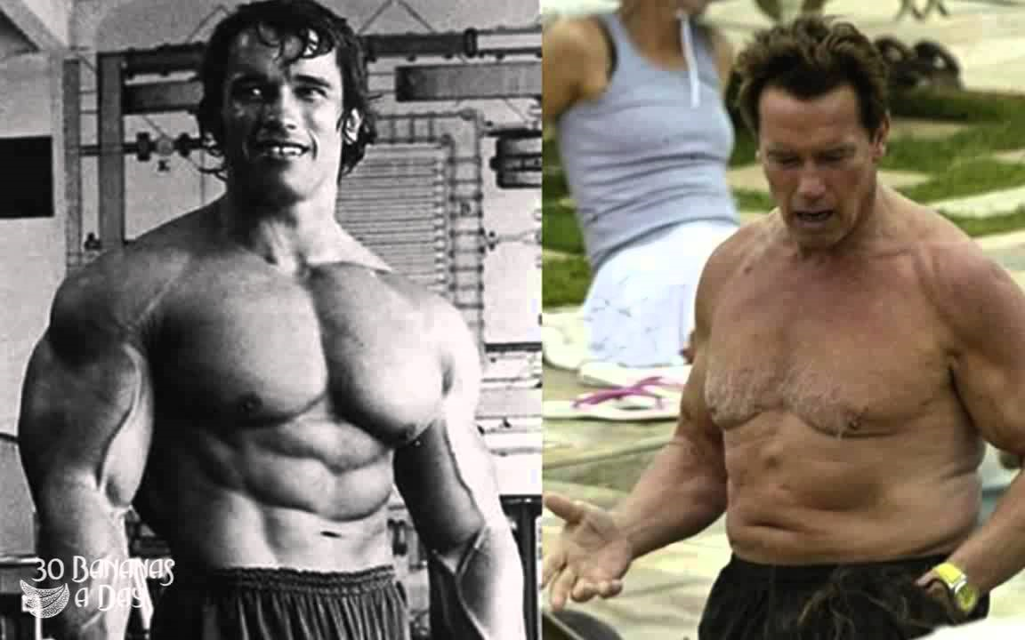

Slide 31
FDA Position Statement:
Testosterone products are FDA approved ONLY for use in men who lack or have low testosterone levels in conjunction with an associated medical condition (Failure of testicles related to genetic problems, chemotherapy, brain structural issues).
None of the FDA approved testosterone products are approved for use in men with low T levels who lack an associated medical condition.
Adapted from FDA website. 2023

Slide 32
Why should we all take an interest in our patients and testosterone?

Slide 33


Slide 34
Use, Misuse, and Abuse of Testosterone and Other Androgens
“Healthcare professionals have a crucial role in combating this public health problem in helping the spread of androgen abuse”
Still much we do not know about long term benefits, adverse effects, appropriate patients to supplement
Use, Misuse, and Abuse of Testosterone and other Androgens: Bruno L Linhares et al. Sex Med Rev. 2022 Oct.

Slide 35
United States Age Demographics
Men > 65 years (millions)
Year
*
United States Census Bureau

Slide 36
Prevalence of Low T:
13 million men in the US
The relative risk of Low T is greater with each 10-year increase in age.
50.0
(32.7–67.3)
70
60
45.5
(39.0–52.1)
40.2
36.6–43.8)
39.9
(35.4–44.4)
50
38.7
(36.6–40.7)
34.0
(30.6–37.4)
40
Prevalence of Low T in All Enrolled
Patients (%, 95%CI)
30
20
10
0
45 to 54
55 to 64
65 to 74
75 to 84
85+
Total
Patient Age Range
Mulligan, et al. Int J Clin Pract. 2006 Jul;60(7):762–769.
*
Notes:
The HIM study that was published in July of 2006 demonstrated that men are more likely to have Low Testosterone with each decade increase in age. One key finding in this study was that 39% of the population of men over 45 years of age had testosterone levels less than 300 ng/dL

Slide 37
Is the Increase in T Rx Patient or Industry Driven?
Sharp increase in T rx in last 10-15 years
  Leading to concerns about market driven over prescription
2007 FDA indicated that as few as 5% of the hypogonadal population was treated¹
2010 review of industry data showed no T product in the top 25 most marked drugs in the U.S.²
2013-2023 over 50% increase in prescriptions
USFDA http://wwwˌfdaˌgov/fdac/departs/196_updateˌhtml
Snyder Bulik B. Ad spending: 15 years of DTC, Ad age Insights White Paper. 2011:3-9

Slide 38
Defining Hypogonadism and Andropause
In older men often referred to as “Andropause” or ADAM (Androgen Deficiency in the Aging Male)
  Unlike menopause not all men will suffer Andropause and the onset is slow over years
  Leading to some controversy if the name Andropause is misleading

Slide 39
Defining Hypogonadism and Andropause
testosterone (hypogonadism) can be associated with a symptom complex affecting:
  Libido
  Energy
  Body fat
  Mentation
  Bone density
  Muscle mass

Slide 40
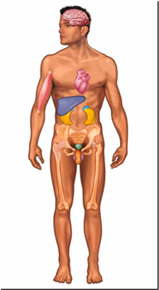
Testosterone’s Impact on the Male Body
Skin
Hair growth, balding,
sebum production
Brain
Libido, mood
Muscle
Increase in strength and volume
Liver
Synthesis of serum proteins
Kidney
Stimulation of erythropoietin production
Bone
Accelerated linear growth,
closure of epiphyses
Bone Marrow
Stimulation of stem cells
Male Sexual Organs
Penile growth, spermatogenesis, prostate growth and function
Pancreas
Increases insulin sensitivity
Morley JE, et al. Metab 2000;49:1239-1242.
AACE Hypogonadism Task Force Endocrinol Pract 2002;8:439-456
2*
Notes:
Testosterone is a very important circulating hormone in the male. Besides being essential for the development of male characteristics and male sexual organs, it also has effects on most major organs, such as Brain, Muscle, Kidney, Bone Marrow, Bone, Liver, and Skin.

Slide 41
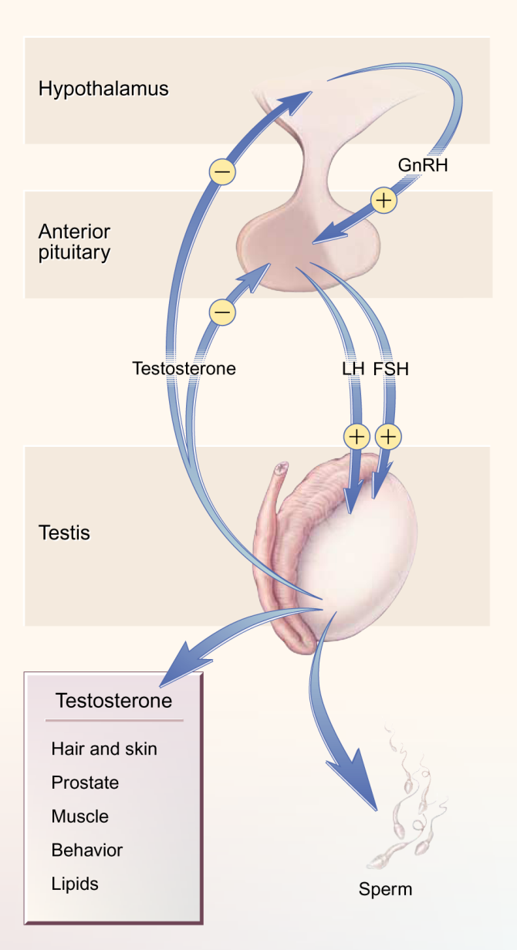
Classification and select causes of Low T
Primary (testicular)
  Congenital - Klinefelter’s and variants
  Mumps and other viruses
  Trauma
  Aging
  HIV/AIDS
Secondary
(pituitary and/or hypothalmus)
  Aging???
  Chronic Illness
  HIV/AIDS
*
Notes:
Low Testosterone may result from a number of disorders, including primary testicular failure (hypergonadotropic hypogonadism – increase in LH and/or FSH) of a genetic or developmental nature (e.g. Klinefelter’s syndrome) or an acquired nature (e.g. mumps and other viruses, trauma, aging, and/or HIV/AIDS). Low Testosterone also may occur with secondary testicular failure (hypogonadotropic hypogonadism – decrease in LH and/or FSH) that may occur with Chronic Illness and/or HIV/AIDS. In normally aging adult men, low testosterone most commonly results from changes associated with aging, obesity, severe systemic illness, and medications. Recent studies have shown that after age 30, men experience a 1% to 2% decrease of total and bioavailable testosterone levels each year—a slow, yet steady decline. In comparison to younger men, most older men have testosterone levels in the low-normal range.

Slide 42
Hypogonadism with Aging
Approximately 700 million Leydig cells at birth
Men lose 6 million cells/yr after age 20
Loss of Leydig cells correlates with progressive loss of T production with age (primary failure)
Decreased GnRH pulse amplitude results in decreased T production (secondary failure)
3*
Neaves WB, J Clin Endocrinol Metab, 1984.

Slide 43
Male Hormonal Status:
Changes with Age as SHBG Increases
FT
*
Adapted from Heaton and Morales. Sex Dysfunction in Medicine. 2000;1:105-111.
Notes:
With aging, the serum T declines slowly, about 1% per year, while the proteins (primarily sex hormone binding globulin, SHBG) that tightly bind the T molecule begin to increase with age. Together, the increased binding and the decrease in production of T leads to a further decrease in the free T with aging.

Slide 44

Making the Diagnosis of Low T
Symptoms & signs
Questionnaires
Confirmatory blood tests
High risk populations

Slide 45
Key Signs and Symptoms to Consider
2010 Endocrine Society Guidelines
Suggested signs and symptoms that would require a serum testosterone level
Symptoms
Signs
Decreased energy or motivation
Depressed mood
Diminished Libido / erectile dysfunction
Poor concentration and memory
Sleep disturbance
Increased body fat, body mass index
Reduced muscle bulk and strength
Low bone mineral density
Loss of body hair (axillary and pubic) hair, reduced shaving
*
Adapted from Endocrine Society Guidelines. 2018
Notes:
The Endocrine Society published their Clinical Practice Guidelines on Testosterone Therapy in Adult Men with Androgen Deficiency syndrome. Included in this slide are specific signs and symptoms that signal the necessity of obtaining a T level.

Slide 46
Endocrine Society Guidelines
“Recommends making a diagnosis of hypogonadism only in men with symptoms and signs consistent with testosterone deficiency and unequivocally and consistently low serum testosterone”
Using accurate assays for total and free T with “rigorously derived reference ranges”
Must repeat the measurement of “morning fasting total T for confirmation
Adapted from Endocrine Society Guidelines. 2018

Slide 47
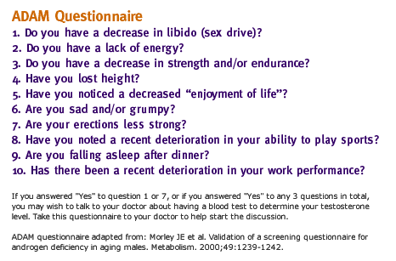
ADAM Questionnaire:
Androgen Deficiency in the Aging Male
AUA recommends against questionairres
*

Slide 48
Confirmatory Blood Tests:
2nd Andropause Consensus Panel
Total T < 300 ng/dl
  Definitely low, AUA supported
Total T 300-400 ng/dl
  Repeat testing
  Clinical considerations
  Check Free T
Total T > 400 ng/dl
  Probably OK
Available at:
http://www.endo-society.org/guidelines/final/upload/final-androgens-in-men-standalone.pdf

Slide 49
Free Testosterone
Free Testosterone is that which is not bound to SHBG
    Considered “Usable Testosterone”
    No established guidelines on how to use free vs Total T
    Many clinicians use total T
    Many experts use Free T
AUA does not support use of Free T and does not consider it interchangeable with Total T

Slide 50

Associated conditions with higher prevalance of Low T
40%
18% of men in a cohort study of 3,700 men with ED had low T¹
30% of HIV-infected men and 50% of men with AIDS may have Low T²
33-50% of men with Type 2 Diabetes may have Low T³
74% of men on sustained-action opioids (chronic pain) may have Low T
35%
33%
30%
30%
25%
20%
18%
% of Men with Low T
15%
10%
5%
0%
ED
HIV
Diabetes
1. Bodie J. et al. J. Urol. 2003;169:2262-64
2. Dobs A.S. Bailliere’s Clin Endorinol Metab 1998;12:370-390
3. Dhindsa S. et al. J Clin Endocrinology Metab 2004;89:5462-5468
4*
Notes:
Low testosterone is more prevalent in patients with certain chronic conditions such as ED, HIV and Type 2 Diabetes. Physicians should be aware of these associations for the purpose of more rigorously screening these patients for low testosterone.

Slide 51

Testosterone Replacement Therapy
Modes of Delivery
Benefits of Therapy

Slide 52
Current Therapies
Route of Administration | Dosing Frequency
Oral | 2-4 times daily
Intramuscular | Every 1-2 weeks
Nonscrotal patch | Once daily
Absorbable gel | Once daily
Mucoadhesive (Buccal) | Twice daily
Long acting Intramuscular Every 10 weeks
Subdermal Pellets Every 3-4 months
Notes:
Testosterone Replacement
Current testosterone replacement therapy includes parenteral (IM, intramuscular), oral dosage forms, transdermal systems, and absorbable gel.
IM injections consist of testosterone esters in an oil-based delivery system (testosterone enanthate and cypionate).
Methyltestosterone, an oral testosterone derivative, is rarely used because of its potential for hepatotoxicity.
Scrotal patches are associated with less skin irritation but can lead to a higher level of DHT due to conversion of testosterone by scrotal skin 5α-reductase.
Reference: Mazer NA, Sanders SW, Ebert CD, Meikle AW. Mimicking the circadian pattern of testosterone and metabolite levels with an enhanced transdermal delivery system. Gurny, Junginger, and Peppas (eds.). In: Pulsatile Drug Delivery: Current Applications and Future Trends. Stuttgart: Wiss. Verlag-Ges.; 1993:73-97.

Slide 53
IM Testosterone
Testosterone Cypionate
  Every 2 week dosing
Testosterone Enanthate
  Xyosted is an example
  Often weekly dosing
Long term injection therapy
  Aveed
  Dosing every 3 months
Notes:
Two available injectable forms of long-acting IM testosterone:
Testosterone enenthate
Testosterone cypionate
Both are non-aqueous and need to be injected in oil. Peak serum concentrations are reached 72 hours after injection (100 to 200mg) and subsequently decline over 1 to 2 weeks.
Supraphysiologic levels (up to 1400 ng/ml) can be reached in the first 72 hours following injection. This has unknown physiologic consequence, but has been linked in some men to sexual and overall behavioral aggressiveness.
Serum levels are not maintained beyond 2 - 3 weeks with higher doses.
DHT levels are usually normal; estradiol levels can be high, causing gynecomastia.
~ $12/injection ($24 per month).
Reference: Morales et al., Andropause: A misnomer for a true clinical entity. J Urol 163:705-712, 2000.

Slide 54
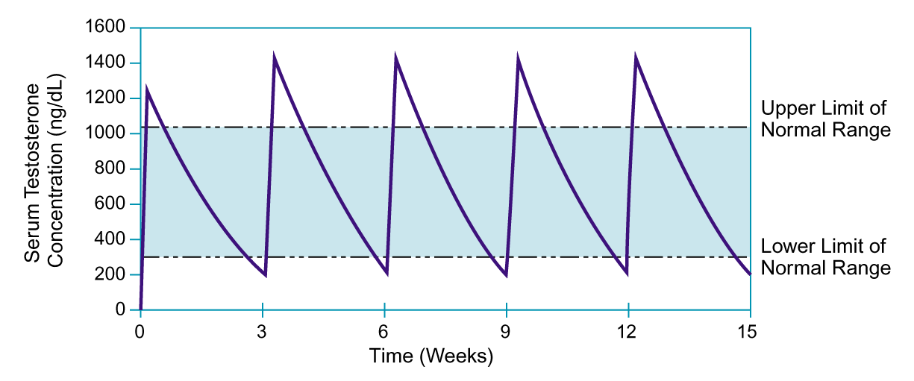
IM Testosterone Enanthate 250 mg
Once Every 2 Weeks
Behre HM, Nieschlag E, Testosterone: Action, Deficiency, Substitution, 1998:329-348.
2*
Notes:
This graph shows the effects of testosterone enanthate 250 mg administered by intramuscular injection every 3 weeks and demonstrates wide fluctuations of serum testosterone levels—beyond the upper and lower limits of normal range.
Peak levels are achieved quickly after administration and often exceed normal physiologic levels. Thereafter, testosterone levels decline, reaching the lower limit or less than normal level just before readministration.
As this chart illustrates, IM testosterone does not provide the smooth, consistent testosterone serum level necessary for optimal therapy.
Behre HM, Nieschlag E. Comparative pharmacokinetics of testosterone esters. In: Behre HM, Nieschlag E, eds. Testosterone: Action, Deficiency, Substitution. Berlin, Germany: Springer-Verlag; 1998:329-348.

Slide 55
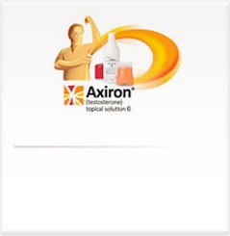
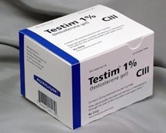
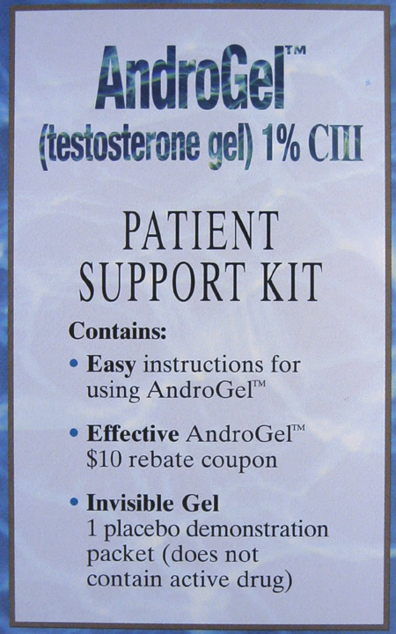

Testosterone Topical:
Daily Application
Clear
Colorless
Hydroalcoholic
Continuous transdermal delivery
Notes:
The gel formulation of testosterone is a clear, colorless hydroalcoholic gel that contains 1% testosterone.
It is applied to intact, clean, dry skin of the shoulders, upper arms, and/or abdomen.
Following a single application, AndroGel® provides continuous transdermal delivery of testosterone, the primary circulating endogenous androgen, for 24 hours.
AndroGel® is indicated for replacement therapy in males for conditions associated with a deficiency or absence of endogenous testosterone, such as primary or secondary hypogonadism. When used in hypogonadal men, this transdermal system can restore testosterone concentrations to the physiologic range of eugonadal men.
Supplied as 5g, 7.5g or 10g (1% testosterone).
~$70-$100 per month.
Data on file. Unimed Pharmaceuticals, Inc.

Slide 56
Testosterone Levels after Replacement Therapy with Patch, Gel or Injection
Patch or Gel
Normal range
1400
Injection
1200
1000
800
T Testosterone ng/dL
Normal
range
600
400
200
0
0
3
5
7
12
17
21
30
34
Day
Adapted from Bhasin and Bremner. J Clin Endocrinol Metab. 1997;82:3-8
Testosterone gel (AndroGel ®1%) Unimed Pharmaceuticals and Solvay Pharmaceuticals, 2002
2*
Notes:
One advantage of the gels over the injections, aside from avoiding liver toxicity, is a longer duration of maintaining T in the normal therapeutic range without the peaks and troughs seen with the IM injections.

Slide 57
Oral Testosterone Replacement
Testosterone Undecanoate Oral is latest oral therapy
Twice daily dosing
Dosing regimen requires adjustments to dosage pending lab levels 4 hours after dosage
  Can be a bit complex

Slide 58
Aromatase Inhibitors
Anastrazole
  Prevents conversion of Testosterone to Estrogen in adipose tissue
  Can be useful in obese men for Testosterone supplementation as an alternative therapy
    Can maintain fertility
    Not recommended in conjunction with T in normal situations
    Not shown to sufficiently increase T in studies
    Some use to keep Estradiol down, but I would argue your T dose is too high
      Can decrease breast development if estradiol too high
Aromatase Inhibitors in men :Effects and therapeutic options. Reprod Biol Endocrinol. 2011; 9: 93

Slide 59
Oral Estrogen Blockage
Clomiphene
  Blocks estrogen receptors centrally
  Can maintain fertility, increase fertility
  Often used as infertility treatment in men
  Daily dosing
  Will increase FSH and LH
  FDA approved for infertility

Slide 60
Benefits of T Therapy

Slide 61
Established Benefits of Normalizing T levels
Positive impact on ED? and libido
Improve energy level, mood and strength
Increased bone mineral density
Increased lean mass and decreased waist circumference
3*

Slide 62
Potential Benefits of TRT
In Diabetic men
  Improved insulin sensitivity
  Reduced blood glucose
  Reduced HbA1c
1. Jones TH, et al. Testosterone replacement in hypogonadal men with type II diabetes and/or metabolic syndrome. Diabetes Care. 2011;34(4):828-837
2. Haider A, et al. Effects of long-term testosterone therapy on patients with “diabesity”: results of observational studies pooled analysis in obese hypogonadal men with type 2 diabetes. Int J Endocinol. 2014;2014:683515
3. Traish AM, et al. Long-term testosterone therapy in hypogonadal men ameliorates elements of the metabolic syndrome: an observational long term registry study. Int J Clin Pract. 2014;68(3):314-329
4. Haider A, et al. Hypogonadal obese men with and without diabetes mellitus type 2 lose weight and show improvement in cardiovascular risk factors when treated with testosterone: an observational study. Obes Res Clin Pract. 2014;8(4):e339-e349

Slide 63
Endocrine Society
Recommends against use in diabetic men as a means of improved glycemic control
Adapted from Endocrine Society Guidelines. 2018

Slide 64
Decreased Libido and Fatigue
Hypogonadal baseline
Testosterone Replacement
Patients (%)
Decreased
Libido
Fatigue
Decreased
Libido
Fatigue
Decreased
Libido
Fatigue
Study I
Study II
Study III
*
Notes:
Patients Reporting Decreased Libido and Fatigue
Study I: During Androderm® treatment, the percentage of patients reporting the symptoms of decreased libido and fatigue were reduced in comparison to the hypogonadal baseline period. During androgen withdrawal, 79% of the patients reported decreased libido and 79% reported fatigue. During Androderm therapy, only 7% of patients reported decreased libido and 10% reported fatigue. These changes were significant (P<0.001) when compared to androgen withdrawal.
Study II showed a smaller reduction in symptoms during Androderm therapy reported compared to historical recollection. During treatment with Androderm, 26% of patients reported decreased libido and 26% reported fatigue compared to 42% reporting decreased libido and 52% reporting fatigue during the historical recollection baseline. No statistical analyses were done.
Study III showed that outcomes during Androderm replacement was intermediate between the other studies. During treatment with Androderm, 30% of patients reported decreased libido and 17% fatigue compared to 52% reporting decreased libido and 57% reporting fatigue during pre-treatment baseline.
Reference: Data on file, SmithKline Beecham.

Slide 65
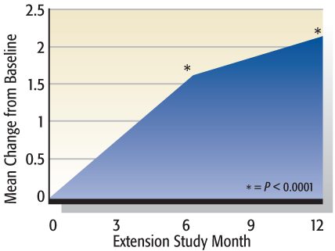
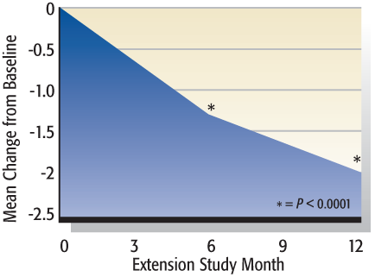
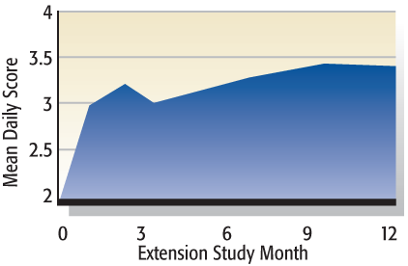
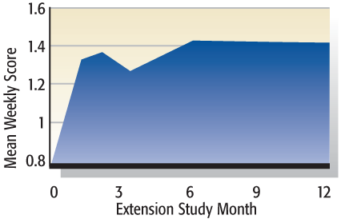
Testosterone Gel: Significantly Improves Key Symptoms of Hypogonadism
Lean Body Mass +4.9 lbs
(P<0.05)
Fat Mass -3.97 lbs
(P<0.01)
Sexual Desire
Sexual Performance
Significant improvement from baseline
Significant improvement from baseline
Adapted Dean J, Reviews in Urology, Volume 6, Supplement 6, 2004.
2*
Notes:
Testim treatment resulted in significant changes in body composition at 6 and 12 months. The changes included significant increase in LBM (1.7 kg month 6, 2.2 kg month 12) and significant decrease in FM (1.2 kg month 6, 1.8 kg month 12). There was no significant change in total body mass.
Sexual function as measured by sexual desire, performance, motivation, satisfaction with duration of erections, percent of full erections, and spontaneous erections, showed significant improvement from baseline at all visits of extension study.
There was a significant change in BMD of lumbar spine as measured by DEXA scan.

Slide 66
Testosterone and PDE-5 Inhibitors
Testosterone has no effect directly on erections
  May improve libido
Testosterone + Sildenafil vs. Placebo + Sildenafil in patients who previously failed sildenafil alone
There was prevalence of men who failed prior sildenafil who were hypogonadal
Worked in men with low/low normal T levels
  Careful, supplementing T can be dangerous
  Perhaps screening men after initial med failure
Testosterone therapy in erectile dysfunction and hypogonadism.
Shabsigh R1. J Sex Med. 2005 Nov;2(6):785-92.

Slide 67
Effects of Testosterone Replacement in Hypogonadal Men
Peter Jˌ Snyder, Helen Peachey, Jesse Aˌ Berlin, Peter Hannoush, Ghada Haddad, Abdallah Dlewati, Jill Santanna, Louise Loh, David Aˌ Lenrow, John Hˌ Holmes, Shiv Cˌ Kapoor, Linda Eˌ Atkinson, and Brian L. Strom
DOI: http://dxˌdoiˌorg/10ˌ1210/jcemˌ85ˌ8ˌ6731
First Published Online: April 25, 2011
18 men
Reached normal T at 3 months, kept in that range
Given for 3 years
  Bone mineral density increase 7.7% (p <.001)
  Increase fat free mass 3.1kg (p=0.004)
  Significant increase in hematocrit
  Increased prostate volume by 10cc
  Self reported sense of energy increased

Slide 68
Testosterone Treatment of Elderly Men:
Bone Mineral Density (BMD)
Testosterone
Bone Mineral Density,
L2-L4 (% Basal)
Placebo
Snyder PJ, et al, J Clin Endocrinol Metab, 1999; 84:1966-1972.
*

Slide 69
Testosterone Treatment and Fractures in Men
5204 Men
2600 T treated, 2603 Placebo
3.19 years follow up
91 fractures in T group
64 fractures in placebo group
No benefit in fracture prevention
Nissen E, Li X et al. Testosterone Treatment and Fractures in Men with Hypogonadism. N Eng J Med. Jan 2024. Vol 390. 203-211.

Slide 70
Endocrine Society
Recommends against use in men over 65 years of age unless symptoms are unequivocally related to T therapy and with a significant discussion of risks and benefits of therapy
Adapted from Endocrine Society Guidelines. 2018

Slide 71
Monitoring

Slide 72
Monitoring of TRT
Test | 1-2 mo. | 3-6 mo. | Yr. | Goal / Comments
Symptom Assessment | X | X | X | Evaluate whether symptoms have responded to treatment or if there are adverse effects
T Level | X | X | X | Therapy should aim to raise serum testosterone levels into the mid-normal range
PSA / DRE |  | X | X | Obtain urological consultation if: - PSA > 4.0 ng/mL (Note: age-specific) or increased > 0.75 ng/mL within any 12 month period - Detection of a prostatic abnormality on DRE
Hematocrit |  | X | X | If hematocrit is >54%, stop therapy until hematocrit decreases to a safe level
Adapted from Endocrine Society Guidelines. July 2006
Notes:
It is important to monitor patients receiving testosterone replacement therapy. Prior to initiating testosterone replacement therapy a baseline measurement of testosterone level should be done as well as PSA, Hgb and Hct, DRE, IPSS or equivalent, and evaluation of sleep apnea risk.

Slide 73
Monitoring TRT
Must also consider effects on liver
    Monitor LFT
    Monitor Lipid Panels
        Can have significant effects on HDL

Slide 74
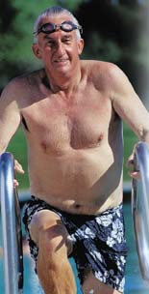
Potential Risks of Treatment with Testosterone Replacement Therapy

Slide 75
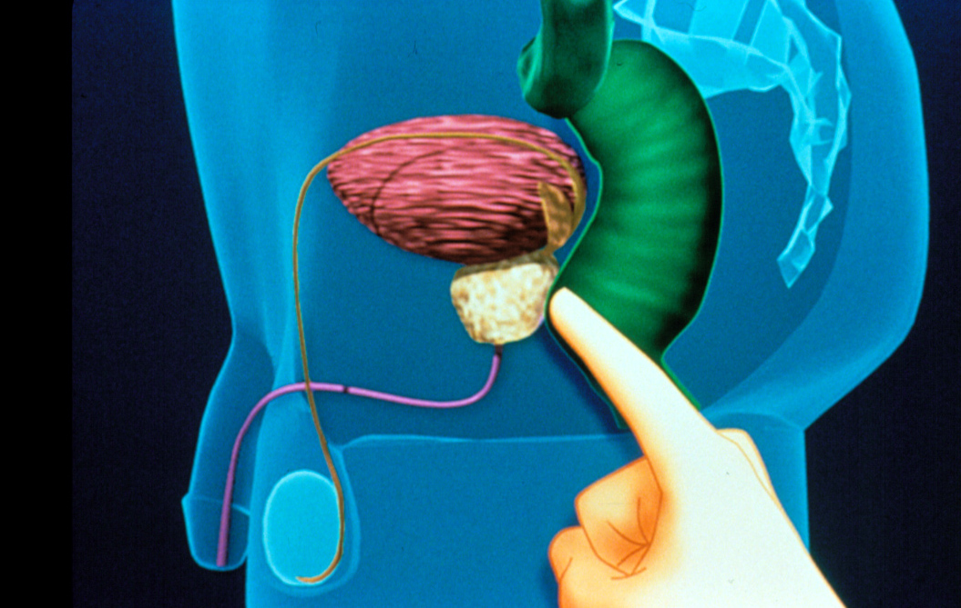
Areas of Concern with TRT
    BPH
    Prostate Cancer
    Heart Disease

Slide 76
Potential Risks in Testosterone
Replacement Therapy
Patients to Avoid
Known or suspected cancer of the prostate or breast
Prostate nodule or induration found on DRE
Unexplained PSA elevation
Erythrocytosis (hematocrit>50%)
Severe LUTS associated with BPH (IPSS>19)
Unstable severe CHF (Class III or IV)
Other Potential AE’s
Erythrocytosis
Acne and oily skin
Reduced sperm production and fertility
Detection of subclinical prostate cancer?
Growth of metastatic prostate cancer
Adapted from the Endocrine Society Guidelines. 2010.
*
Notes:
A prostate nodule or induration or an elevated PSA may indicate previously unrecognized prostate cancer. Furthermore, in men with erythrocytosis, untreated obstructive sleep apnea, severe lower urinary tract symptoms or severe congestive heart failure, testosterone may worsen these conditions.

Slide 77
Polycythemia
Most common side effect I see
  Higher with injection therapy
My current protocol:
  Hematocrit under 48
    no concern
  Hematocrit 48-50
    Hydration, closer lab follow up
  Hematocrit 50-52
    Decrease dose, hydration
  Hematocrit 52-55
    Stop treatment, hydration, consider blood donation
  Hematocrit >55
    - Stop treatment, immediate blood donation (red cross)

Slide 78
Testosterone and Prostate growth
Limited studies showed increased prostate volume when followed serially on testosterone therapy
Likely some men will progress in BPH symptoms on testosterone therapy

Slide 79
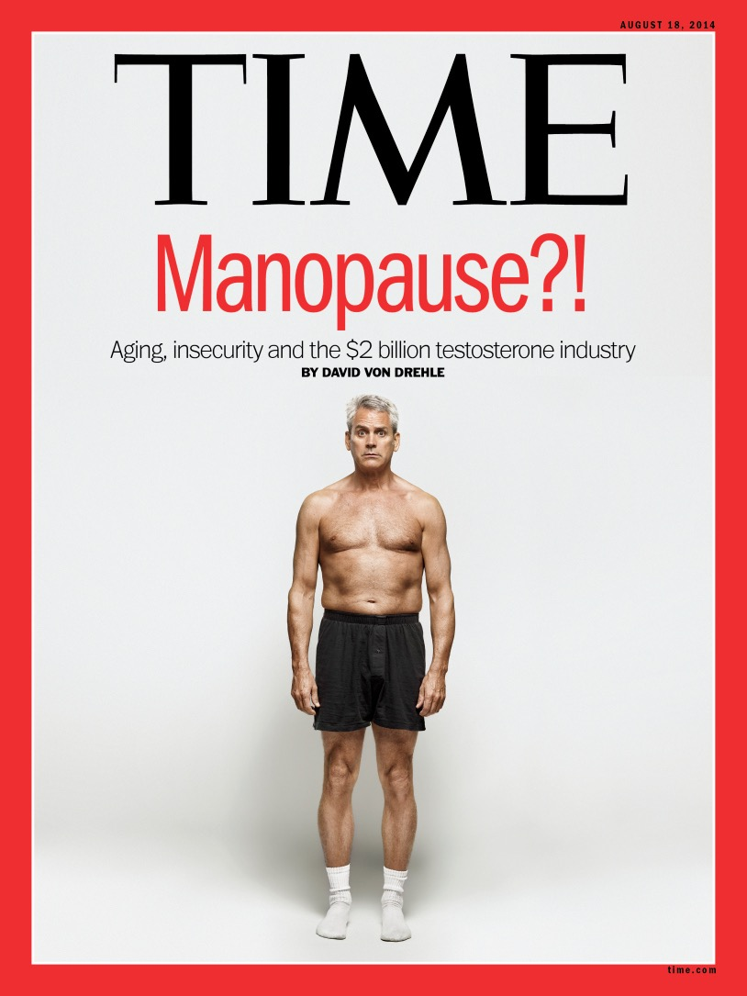
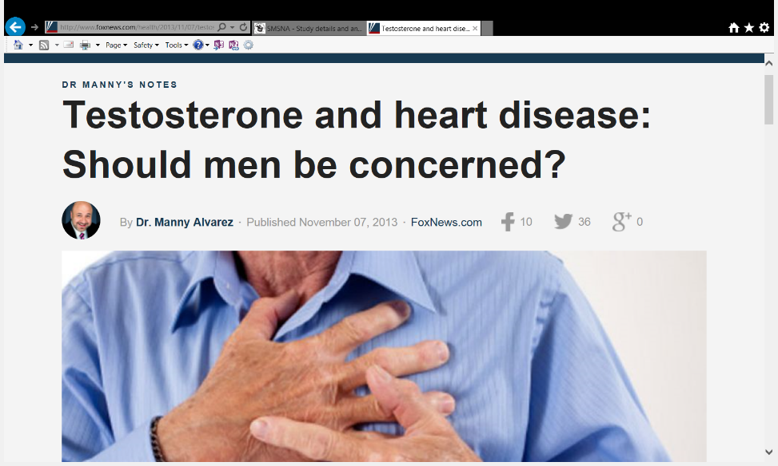
TRT and CV RISK in the News
How did this Frenzy start ?

Slide 80
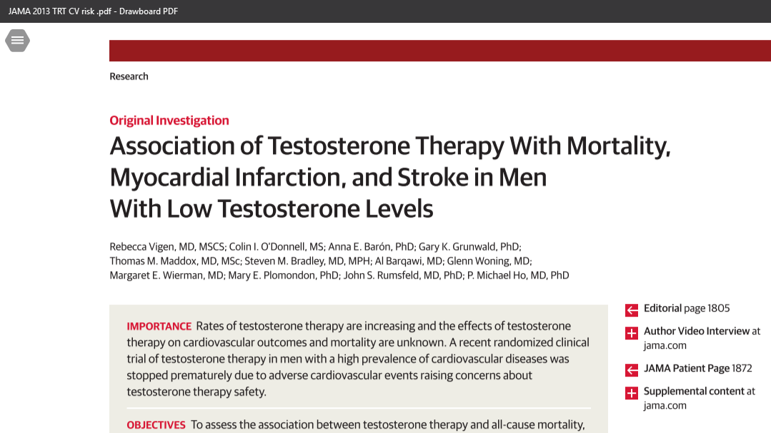
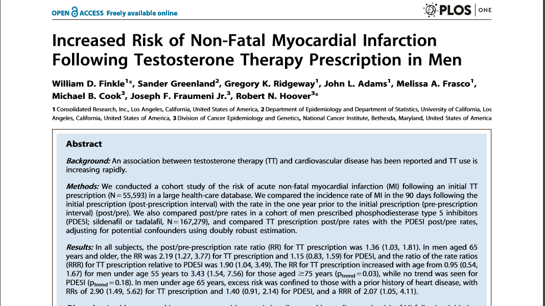
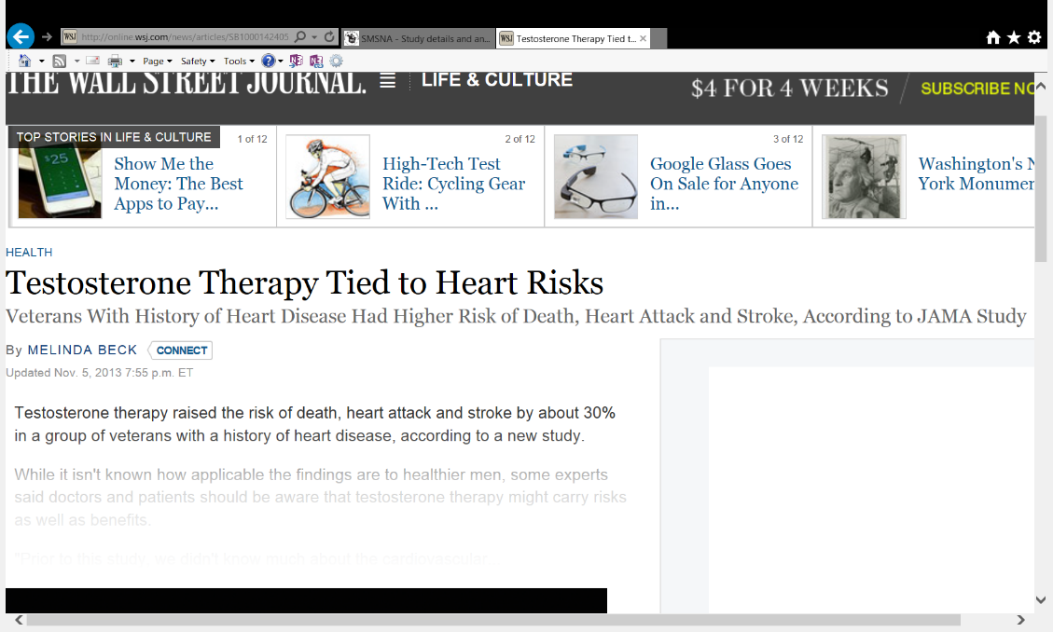

Slide 81
Association of Testosterone Therapy With Mortality, Myocardial Infarction, and Stroke in Men With Low Testosterone Levels
Rebecca Vigen, MD, MSCS1; Colin I. O’Donnell, MS2,3; Anna E. Barón, PhD2,3; Gary K. Grunwald, PhD2,3; Thomas M. Maddox, MD, MSc2,3,4; Steven M. Bradley, MD, MPH2,3,4; Al Barqawi, MD3; Glenn Woning, MD3; Margaret E. Wierman, MD2,3; Mary E. Plomondon, PhD2,3,4; John S. Rumsfeld, MD, PhD2,3,4; P. Michael Ho, MD, PhD2,3,4
JAMA. 2013;310(17):1829-1836. doi:10.1001/jama.2013.280386.
8709 Men
T less than 300
1223 Started T therapy
25.7% of T therapy with CV event
19.9% in non-T group
    5.8% absolute risk difference (statistically significant)
All men had previous cardiac cath!
10% of control group were women

Slide 82
JAMA Article
Association of testosterone therapy with mortality, myocardial infarction, and stroke in men with low testosterone levels
was a retrospective analysis of a dataset of 8709 men in the VA health system who had undergone coronary angiography.
Among men with testosterone concentrations less than 300ng/dl, the authors reported an increased rate of heart attacks, strokes, and deaths in men who received a testosterone prescription compared with men who did not.
Although no significant differences in event rates were noted at any year of follow-up, a significant increase of 29% for testosterone-treated men was reported over the course of the study
Vigen R, O'Donnell CI, Barón AE, Grunwald GK, Maddox TM, Bradley SM, Barqawi A, Woning G, Wierman ME, Plomondon ME, Rumsfeld JS, Ho PM. Association of testosterone therapy with mortality, myocardial infarction, and stroke in men with low testosterone levels. JAMA. 2013;310:1829-1836.

Slide 83
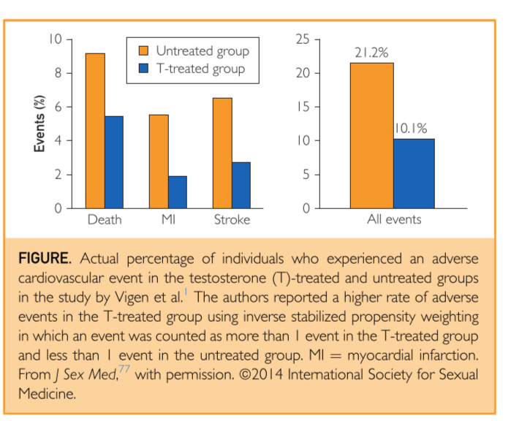
JAMA Article
Association of testosterone therapy with mortality, myocardial infarction, and stroke in men with low testosterone levels
Curiously, the percentage of men who suffered an event was actually lower by one half for the testosterone group compared with the no-testosterone group (10.1% vs 21.2%).

Slide 84
JAMA Article
Association of testosterone therapy with mortality, myocardial infarction, and stroke in men with low testosterone levels
The authors came to an opposite conclusion resulting from complex statistical modeling based on more than 50 variables, including time. However, this modeling failed to include substantially lower baseline testosterone levels in the T group,
These statistical adjustments resulted in an estimated cumulative event rate for the testosterone group of >30% compared with the actual rate of only 10.1%. This multiplier effect for events also multiplies the magnitude of errors, raising considerable concern regarding the reliability of results.

Slide 85


Slide 86
PloS One Article
Increased risk of non-fatal myocardial infraction following testosterone therapy prescription in men
Retrospective review of insurance company database
Reported rates on non-fatal MI in the 90 day period after T Rx
Compared to the prior 12 mo MI rates
The authors reported rate ratio of MI post Rx as 1.36 and the rate in men older than 65 yrs was 2.19
Comparison used was MI rate post Rx for PDE5 inhibitor
Finkle WD, Greenland S, Ridgeway GK, et al. Increased risk of non-fatal mycocardial infarction following testosterone therapy prescription in men. PloS One. 2014;9(1):e85805

Slide 87
PloS One Article
Increased risk of non-fatal myocardial infraction following testosterone therapy prescription in men
Database was limited to diagnosis codes, procedure codes and Rx info
No info regarding CV related risk factors
  DM, HTN, hyperlipidemia, smoking, obesity
No Follow up to verify an event occurred
Not limited to primary admitting diagnosis or any other limiting factor

Slide 88
PloS One Article
Increased risk of non-fatal myocardial infraction following testosterone therapy prescription in men
The post Rx MI rate likely represents an approximation ( limited by collection technique) of the naturally occurring MI rate in this group
However, the pre RX MI rate really reflects the willingness of Docs to prescribe TRT to men with recent MI.
  Any reluctance to rx TRT in men with recent MI would drastically alter the pre RX MI rate by selection bias
The overall MI rate would be low reported as 4.75 events per 1000 person-years
  Compared to 13 expected events per 1000 person-years referencing the NIH heart attack risk calculator and inputting the age 54, average age of the cohort and favorable modifiers
  MI rate was 1/3 the predicted

Slide 89
PloS One Article
Increased risk of non-fatal myocardial infraction following testosterone therapy prescription in men
Lastly on this study the comparison to PDE5 inhibitors is like comparing apples and oranges
  Different likely patient demographics
  PDE5’s are vasodilators and may have cardio protective effects

Slide 90
Coronary Plaque Volume
170 men
138 T replacement, 65 placebo
Measured coronary calcium score at 12 months
Significant increase in coronary artery non calcified plaque volume
Budoff et al. Testosterone treatment and Coronary Artery Plaque Volume in Older Men with Low Testosterone. JAMA. 2017. Feb 21; 317(7)708-716.

Slide 91
TRT and CV Risk
SMSNA Position Statement
As a professional society dedicated to the effective and safe treatment of individuals with sexual dysfunction and men’s health overall, the Sexual Medicine Society of North America is aware of recent concerns regarding cardiovascular risks associated with the use of testosterone therapy. This concern stems from two journal articles, one published in November 2013 in the Journal of the American Medical Association, and the other published in January 2014 in the journal, Plos One. Neither of these reports was a planned experimental study with control groups and defined goals. Instead these were retrospective analyses of data collected for other reasons. These types of analyses are prone to bias and error, and results are often irreproducible (3). For this reason, this type of study is generally not used for medical decision-making, although in some cases these may prompt further investigation with an experimental study.
http://www.smsna.org/V1/index.php/about/position-statements

Slide 92
Hypogonadism and CV RISK
Multiple studies prior showing that CV risk is linked to low testosterone and that replacement therapy may lower risks
Oskui PM, French WJ, Herring MJ, Mayeda GS, Burstein S, Kloner RA. Testosterone and the cardiovascular system: a comprehensive review of the clinical literature. J Am Heart Assoc. 2013 Nov 15;2(6):e000272
Carson CC and Rosano G. Exogenous testosterone, cardiovascular events, and cardiovascular risk factors in elderly men: A review of trial data. J Sex Med 2012;9:54–67.
Traish AM, Miner M, Zitzmann M, Morgentaler A. Testosterone deficiency. Am J Medicine, 124, 578-587, 2011.
Aversa A, Bruzziches R, Francomano D, Rosano G, Isidori AM, Lenzi A, and Spera G. Effects of testosterone undecanoate on cardiovascular risk factors and atherosclerosis in middleaged men with late onset hypogonadism and metabolic syndrome: Results from a 24-month, randomized, double-blind, placebo-controlled study. J Sex Med 2010;7:3495–3503.

Slide 93
Cardiovascular risk associated with testosterone-boosting medications: a systematic review and meta-analysis
75 studies reviewed
3016 men treated with T and 2446 treated with placebo
Mean treatment 34 weeks
Found no significant association between T therapy and CV events
Studies in men with metabolic derangements revealed a protective effect
Corona G. et al. Cardiovascular risk associated with testosterone-boosting medications: a systematic review and meta-analysis. Expert Opin Drug Saf. 2014;13(10):1327-1361.

Slide 94
Decreased Life Span and Hypogonadism
Several longitudinal population-based studies have demonstrated reduced longevity in men with low T levels
Shores MM, Matsumoto AM, Sloan KL, Kivlahan DR. Low serum testosterone and mortality in male veterans. Arch Intern Med. 2006;166:1660–1665.
Laughlin GA, Barrett-Connor E, Bergstrom J. Low serum testosterone and mortality in older men. J Clin Endocrinol Metab. 2008;93:68–75.
Khaw KT, Dowsett M, Folkerd E, Bingham S, Wareham N, Luben R, Welch A, Day N. Endogenous testosterone and mortality due to all causes, cardiovascular disease, and cancer in men: European prospective investigation into cancer in Norfolk (EPIC-Norfolk) Prospective Population Study. Circulation. 2007;116:2694–2701.
Haring R, Volzke H, Steveling A, Krebs A, Felix SB, Schofl C, Dorr M, Nauck M, Wallaschofski H. Low serum testosterone levels are associated with increased risk of mortality in a population-based cohort of men aged 20-79. Eur Heart J. 2010;31:1494–1501.

Slide 95
Normalization of testosterone level is associated with reduced incidence of myocardial infarction and mortality in men
Rishi Sharma, Olurinde A. Oni, Kamal Gupta, Guoqing Chen, Mukut Sharma, Buddhadeb Dawn, Ram Sharma, Deepak Parashara, Virginia J. Savin, John A. Ambrose, Rajat S. Barua
DOI: http://dxˌdoiˌorg/10ˌ1093/eurheartj/ehv346 ehv346 First published online: 6 August 2015
83,000 men
All cause mortality, MI risk, stroke lower risk in T replaced group with normalization of T levels when compared to T replacement and not achieving normalization
Same with T replacement vs. No replacement

Slide 96
Traverse Trial
5246 men
2 levels below 300
45-80 years old
Pre-existing or high risk of CV disease
Randomized, placebo controlled
  Testosterone gel vs placebo
  Goal T 350-750
Mean 21 months of treatment
Mean follow up 33 months

Slide 97
Traverse Trial
Testosterone was non inferior to placebo with respect to major adverse cardiac events
  7% in T group
  7.3% in placebo group
Some higher risks reported in T treatment group
  AKI
  Afib
  Pulmonary Embolus
Travison T, Nissen S et al. Cardiovascular Safety of Testosterone Replacement Therapy. N Eng J Med. July 2023. Vol 389. 107-117.

Slide 98
Traverse Trial
FDA has removed black box warning against cardiovascular events

Slide 99
Traverse Trial Flaws
60% discontinuation rate for treatment
Men in the study reached just above 350 T level on average
  This is significantly lower than most of our patients run
Travison T, Nissen S et al. Cardiovascular Safety of Testosterone Replacement Therapy. N Eng J Med. July 2023. Vol 389. 107-117.

Slide 100
Testosterone and Prostate Cancer

Slide 101
Prostate and Testosterone
Men age 55-69, must discuss prostate cancer screening and risk
Men age 40-55 with increased prostate cancer risk (African American, first degree relative with prostate cancer) must discuss prostate cancer risk
Recommended following PSA closely for 3-12 months after starting therapy, then normal intervals following
Evaluation recommended if PSA >4.0, has increase > 1.4ng/mL above baseline, or abnormality detected on prostate exam
  Must check prostate
Adapted from Endocrine Society Guidelines. 2018

Slide 102
Normal Patients
Prostate cancer rate in 7 published TRT trials was similar to screening trials of general population¹
PSA values do not significantly increase after TRT⁽²⁻⁴⁾
Most studies have NOT demonstrated an association between elevated testosterone and prostate cancer⁵
Rhoden, Morgentaler, 2004.
Marks L et al. JAMA 296:2351, 2006.
Rhoden El, Morgantaler A J Urol 2003.
Rhoden El, Morganter A Int J Impot Res 2006.
Hsing AW Epidemiol Rev 2001.
2*
Notes:
Rhoden El, Morgentaler A Engl J Med 2004
Marks L et al. JAMA 296:2351, 2006
Rhoden El, Morgantaler A J Urol 2003
Rhoden El, Morganter A Int J Impot Res 2006
Barqawi et al. Int J Impot Res 2005
Rhoden El, Morgentaller A J Urol 2003
Morgantaler A. Eur Urol 2006
Hsing AW Epidemiol Rev 2001

Slide 103
What about Supplements?
Society of Endocrinology and American Urological Association do not support the use of Bio Identical hormone replacement
Numerous supplements being studied showing a benefit to Testosterone levels

Slide 104
Ashwagandha
Lopresti 2019
  Randomized placebo controlled double blind study
  18% increase in DHEA
  147% increase in T levels
Chauhan et al 2022
  Randomized placebo controlled
  Increase in serum testosterone levels and feeling of sexual well being
Can improve sleep, anxiety
Decrease oxidative stress

Slide 105
Ashwagandha
Difficult getting consensus on dosage
  Studies were 300mg BID
Side Effects
  nausea
  Headaches
  Rare liver risk, possibly exacerbated by alcohol
Can be taken daily, but many studies were only 3 months long
  I often recommend taking breaks from supplementation

Slide 106
Fenugreek
Drevon et al 2024
  95 men
  0-1800mg supplementation
  Increase total and free T at any dose

Slide 107
Ginger
Numerous studies showing enhanced Testosterone production
Improved semen quality
Possible benefits in infertility
Decreased oxidative stress
May enhance central hormone production

Slide 108
Other Supplements
Red Ginseng
  May decrease conversion of T to DHT
Tribulus
  Not shown to increase T in humans
Tongkat Ali
  Possibly some benefit to ED and T levels
  Only 50% had improved T levels in some studies

Slide 109
Things I have seen….

Slide 110
24 year old comes in for PSA of 23. He was started on Testosterone supplementation at 19 for “low T”
Original T value was 395 (normal range) but was told that it was “low for his age”
  We have no age based ranges for T
His PSA decreased with stopping T
He is now Testosterone dependent
  Testicular function never recovered
Has infertility

Slide 111
45 year old comes in for PSA of 4.1
Started Testosterone 3 years ago
  He was on Testosterone cypionate, Arimidex, and Clomid
  T level 1800
  Hematocrit 57
    Doing twice monthly “blood dumping”
Prostate biopsy benign
Very difficult to wean him from this regimen

Slide 112
38 year old comes in for infertility
After discussion, figured out he was on T supplementation
  Truly low T, testicular hypofunction
Was never told that testosterone causes infertility
  Negative feedback on FSH
Changed to Clomid
Luckily, testicular function recovered, resulted in pregnancy

Slide 113
  72 year old sent for low T
  Multiple checks, first morning, fasting
    T 186
    Had muscle loss, anemia, fatigue, low libido
  Started Testosterone therapy, normalized T, gained muscle mass, anemia improved
  Monitored every 6 months with labs
  Did well with therapy

Slide 114
Summary

Slide 115
Summary
Androgen deficiency in adult men is often underdiagnosed but controversial
As men age, T levels gradually diminish, often to hypogonadal levels, ? normal
Andropause is characterized by changes in:
  Body fat/lean muscle ratio
  Bone mineral density
  Cognition, memory, and mood
  ↓ sexual desire and function
TRT can increase hormone levels to normal ranges, significantly improve symptoms and is safe with proper monitoring
3*
Notes:
Hypogonadism affects 4 to 5 million men, of whom only 5% receive treatment. In adults, hypogonadism is often underdiagnosed because its symptoms are mistaken for “getting older” or ignored by patients and physicians.
Testosterone levels diminish at about 1% to 2% a year after age 30, eventually reaching hypogonadal levels in some men.
Urologists should evaluate healthy older men who present with complaints of decreased libido, diminished erections, or changes in energy or “pep” for andropause-related hypogonadism.
Testosterone replacement therapy can return hormone levels to normal ranges and help alleviate the symptoms and clinical detriments associated with hypogonadism. In older men, therapy may help to improve cognition, bone mineral density, lipid profiles, and sexual function. Testosterone replacement is contraindicated in men with preexisting breast or prostate cancer. All older men should have regular examinations so changes in the prostate or PSA levels can be quickly addressed.

Slide 116
Summary
Must follow Hematocrit, PSA, testosterone, LFT, Lipid panels, prostate exam and symptoms every 6 months
    Hematocrit over 52%, must stop
Testosterone is still not FDA approved for replacement for normal testosterone loss of aging
    However, no normal has been described
Studies showing increased CV risk poorly done

Slide 117
